Slide 1
Scraping Tables from websites
Austin Walker

Slide 2
Agenda
Easy process to scrape tables that will work for most scenarios
Using Selenium to work around a specific roadblock
Tools for those who do not want to write the code themselves
ScrapingBee Example

Slide 3
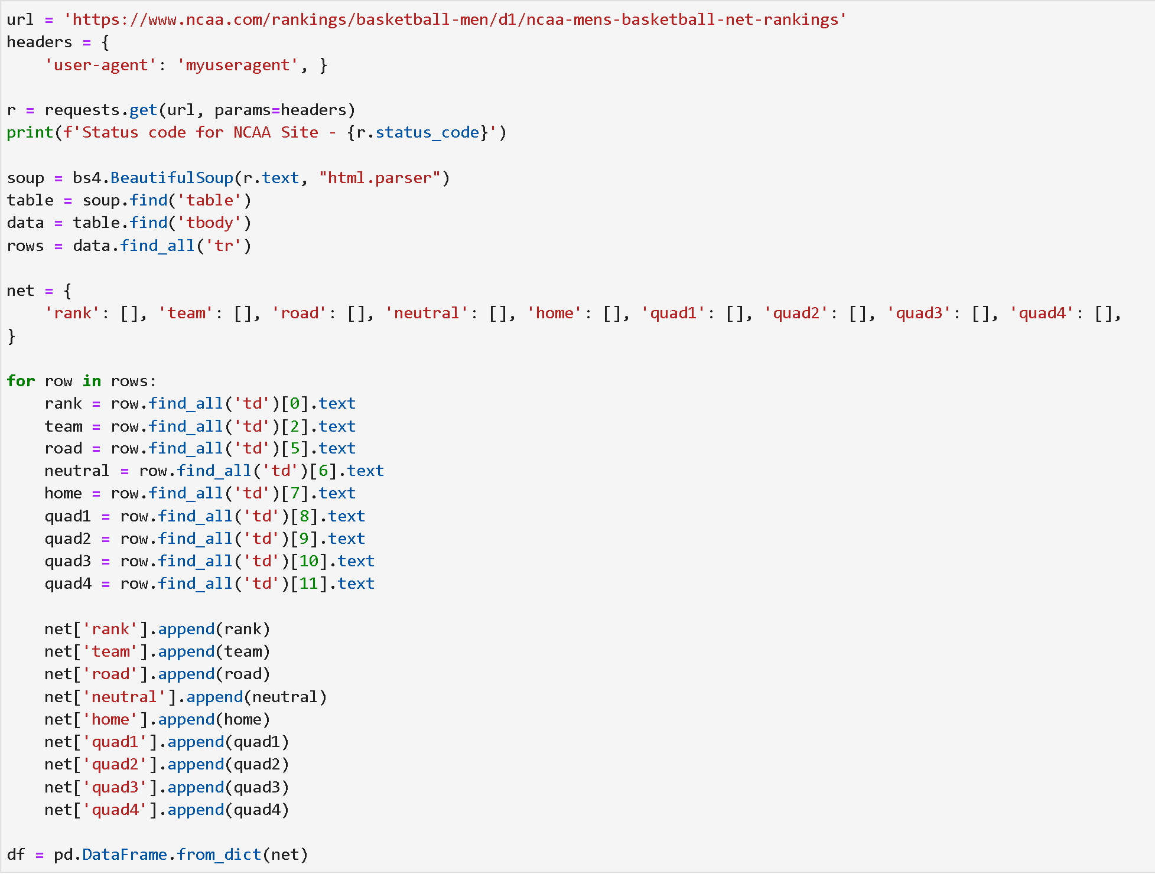
Scraping Tables - easy Process
Steps:
Send Request
Get html as text
Begin Parsing through text
Table
Table body
Table rows
Iterate through each row and grab data
Append data to a dictionary and create dataframe

Slide 4
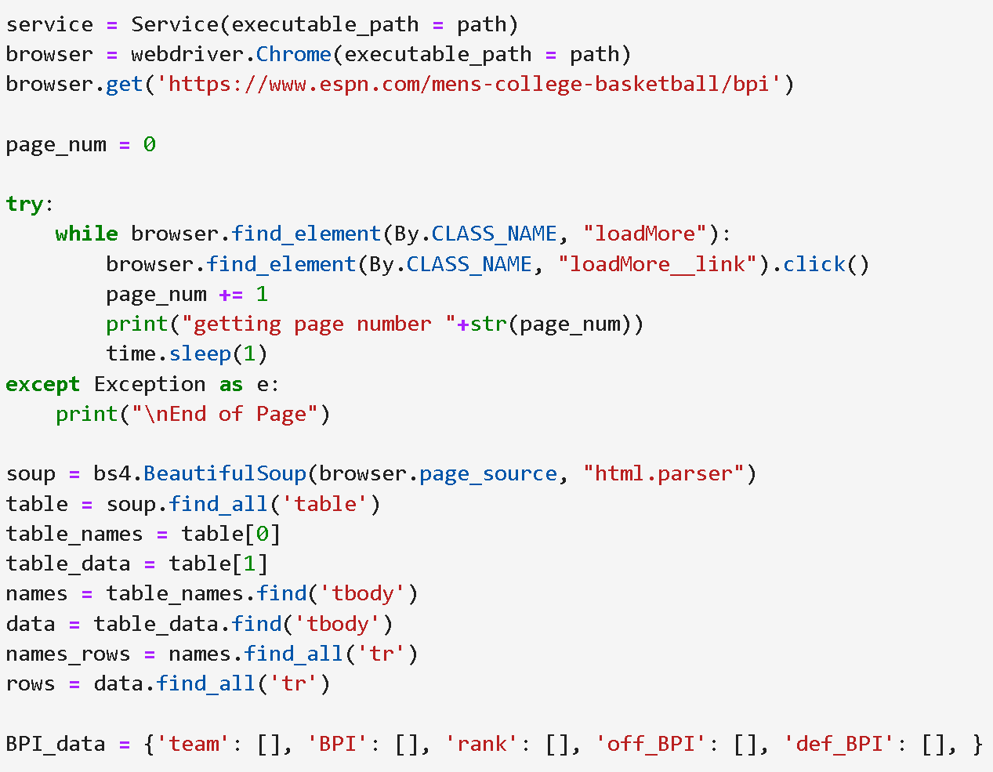
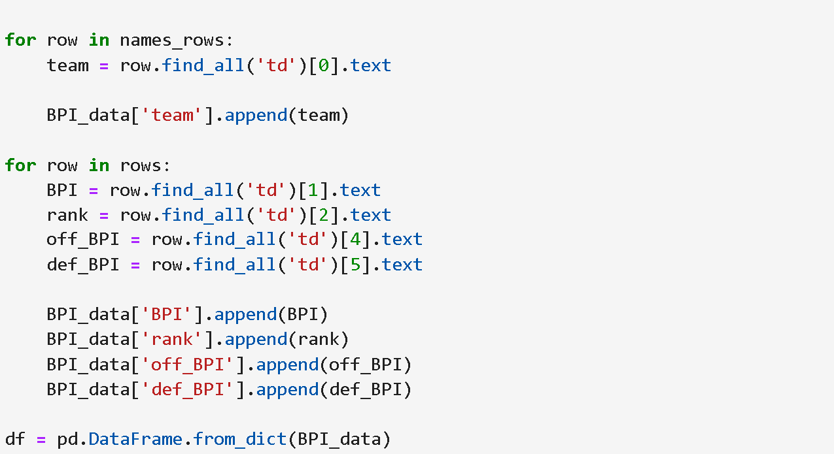
Scraping Tables - “See More” Roadblock
Steps:
Create a path for our browser
Use the click() element to show the entire table
Same as steps 2-5 from the previous process
This time we have to split iteration into two steps to get two different tables (one for names, the other for data)

Slide 5


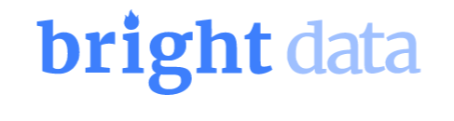
Web scraping tools
These are web data collection platforms that provide web scraping and proxy server services.
They offer easy access to web scraping APIs
Examples
ScrapingBee
OxyLabs
Bright Data

Slide 6

ScrapingBee
Created by Kevin Sahin and Pierre de Wulf
Provides the use for companies or individuals to extract data without getting blocked
Uses a large amount of proxies
No rate limit due to using these proxies
Provides an API to make web scraping easier without writing code
Example

